Slide 1
Theory of Computation
CSE 3101
Lecture # 13
Md. Manowarul Islam
Lecturer, Dept of CSE
Jagannath University

Slide 2
Linear Grammars
Grammars with at most one variable at the right side of a production
S aSb
S ∧

Slide 3
Right-Linear Grammars
All productions have form:
Example
A→ xB
or
A→ x
terminals
S abS
S a

Slide 4
Left-Linear Grammars
All productions have form:
Example
A→ Bx
or
A→ x
terminals
S Aab
A Aab | B
B a

Slide 5
FA to Right-Linear Grammar
The algorithm to convert the finite automata (FA) to the right linear grammar is as follows −
Step 1 − Begin the process from the start state.
Step 2 − Repeat the process for each state.
Step 3 − Write the production as the output followed by the state on which the transition is going.
Step 4 − And at last, add ε (epsilon) to end the derivation.

Slide 6
FA to Right-Linear Grammar
The algorithm to convert the finite automata (FA) to the right linear grammar is as follows −
The start symbol of the grammar is q₀, the non-terminal corresponding to the start state of the DFA.
For each transition from state q_{i} to state q_{j} on some symbol ‘a’, create a production rule of the form: q_{i} → a q_{j}.
For each state q_{i} of the DFA which is a final state, create a production rule of the form: q_{i} → ε

Slide 7

FA to Right-Linear Grammar
Pick the start state A and output is on symbol ‘a’ going to state B
A→aB
Now we will pick state B and then we will go on each output:
B→aB
B→bB
B→ε
A→aB
B→aB/bB/ε

Slide 8
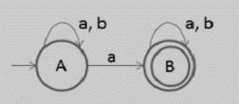
FA to Right-Linear Grammar
Start with state A which is an initial state the output on symbol ‘a’ goes to A and B and the output on symbol ‘b’ goes to A.
Now the production rule of right linear grammar is −
A→aA/bA/aB
Now pick state B and then go on each output the right linear grammar is −
B→aB/bB/ε
A→aA/bA/aB
B→aB/bB/ε

Slide 9
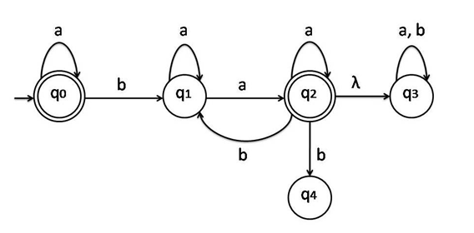
FA to Right-Linear Grammar

Slide 10
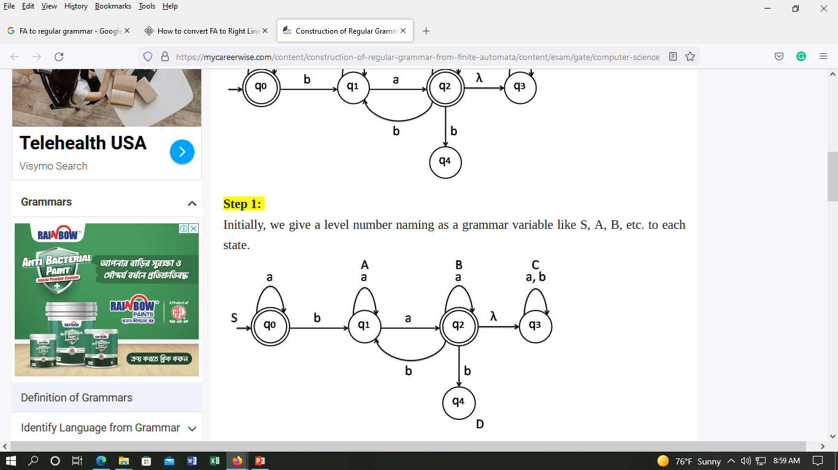
FA to Right-Linear Grammar
𝒒𝟑 𝒒4 are not included because they will never participate to create anything

Slide 11
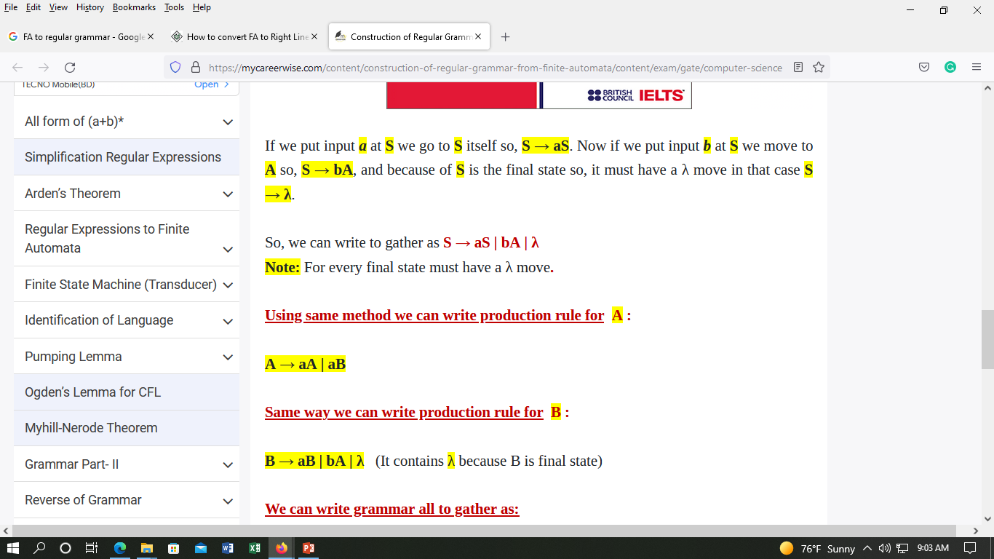
FA to Right-Linear Grammar

Slide 12
FA to Right-Linear Grammar

Slide 13
FA to Right-Linear Grammar

Slide 14
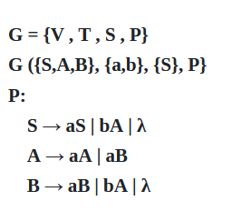
FA to Right-Linear Grammar

Slide 15
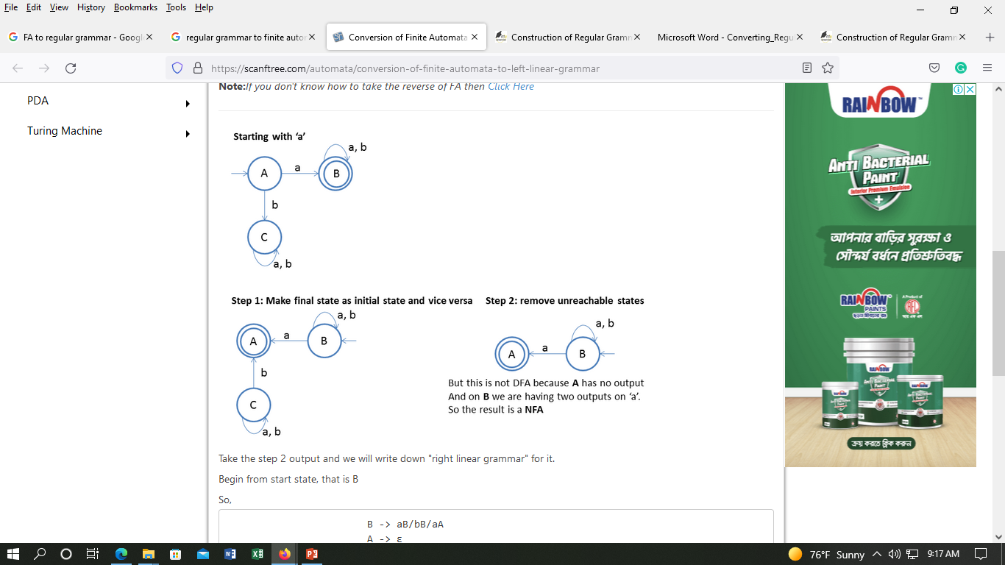
FA to Left-Linear Grammar

Slide 16
FA to Left-Linear Grammar
FA -> Reverse of FA -> Right Linear Grammar -> Reverse of Right Linear Grammar ->Left Linear Grammar

Slide 17
FA to Left-Linear Grammar

Slide 18
FA to Left-Linear Grammar
Take the step 2 output and we will write down "right linear grammar" for it.
Begin from start state, that is B
B -> aB/bB/aA
A -> ε

Slide 19
FA to Left-Linear Grammar
B -> aB/bB/aA
A -> ε
now reverse the right linear grammar to get the ouput = left linear Grammar
B -> Ba/Bb/Aa
A -> ε

Slide 20
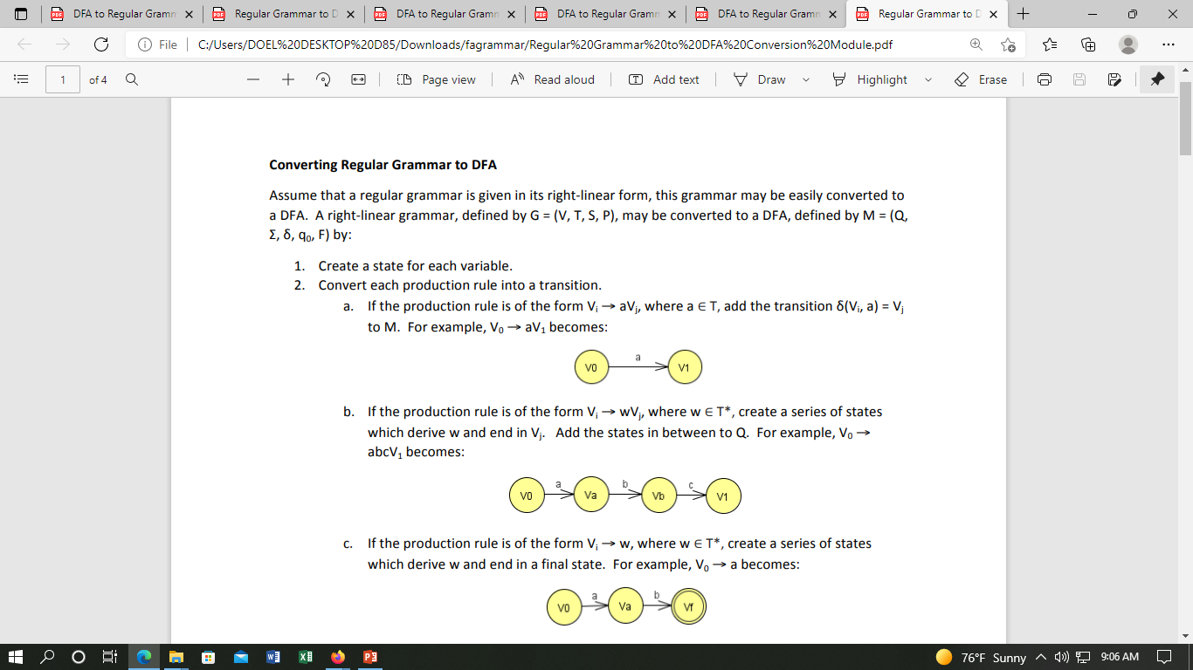
Grammar - FA

Slide 21
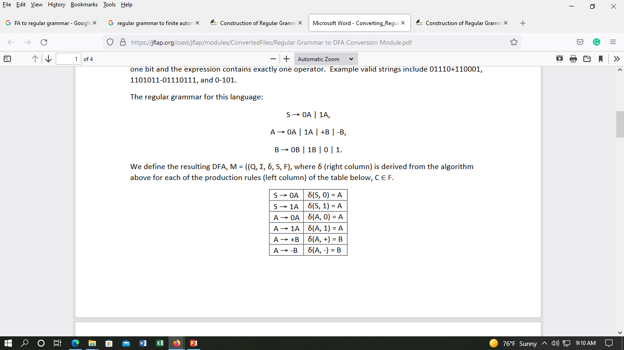
Grammar - FA

Slide 22
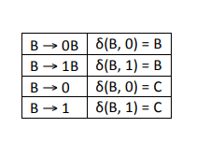
Grammar - FA

Slide 23
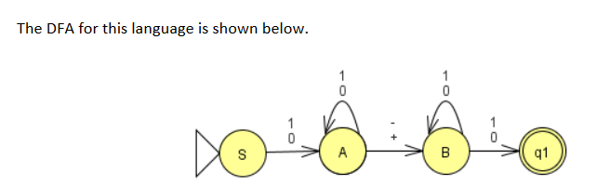
Grammar - FA

Slide 24
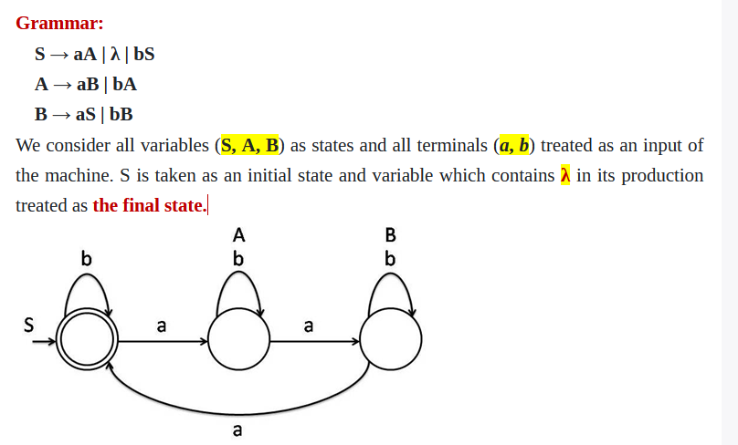
Grammar - FA

Slide 25
END

